Slide 1
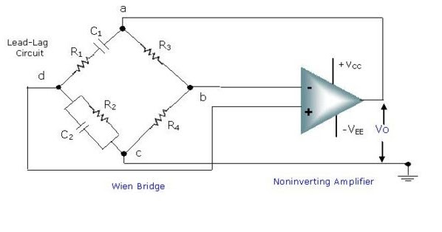
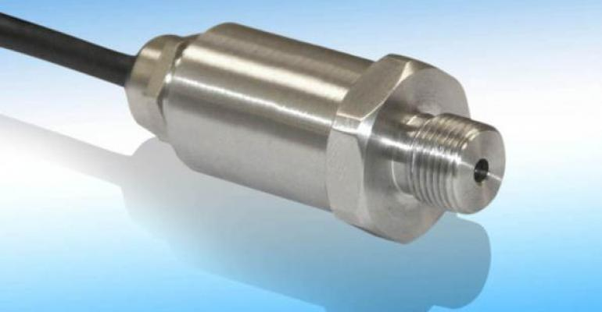
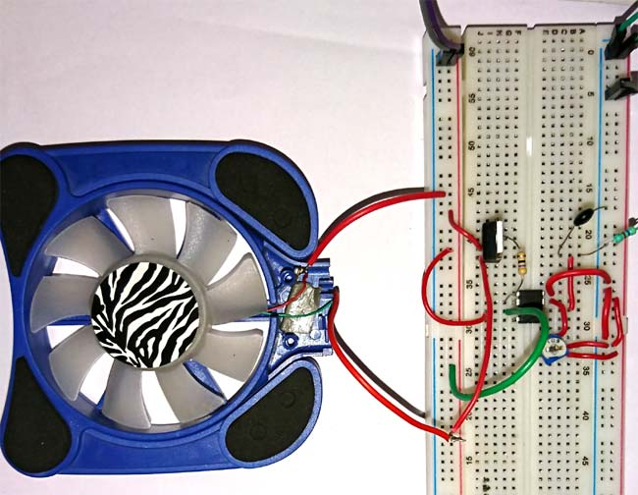
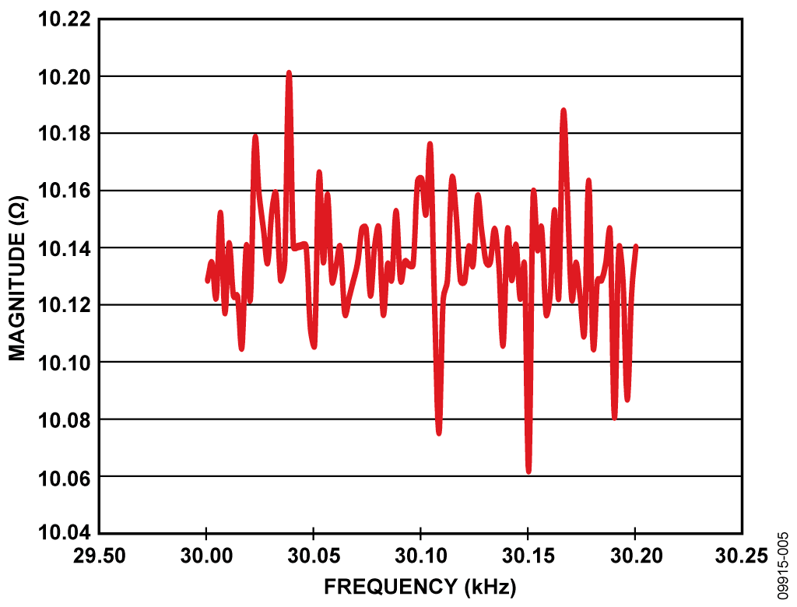
Analog Circuits 101
Dec 2018

Slide 2


Rules of thumb, assumptions and mixed-quality analogies to come!

Slide 3
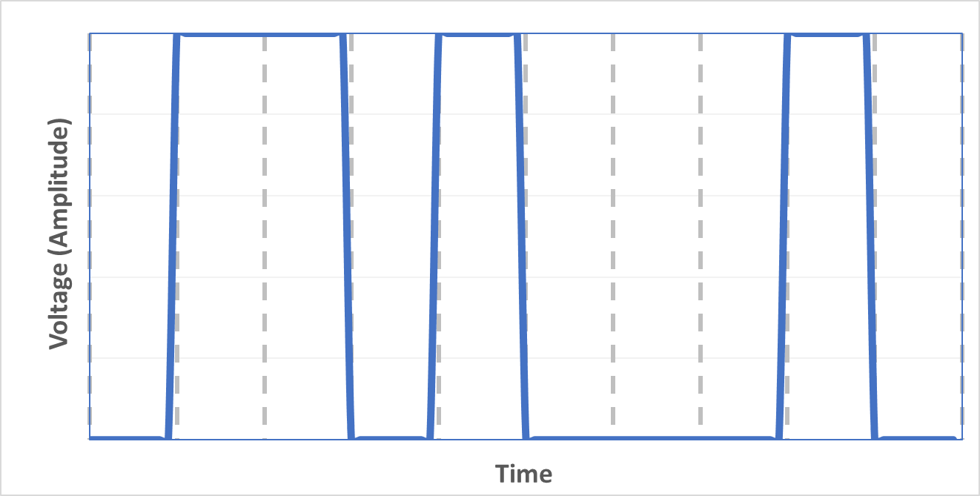
Digital Signals
Discrete in time and amplitude (voltage)
Convey a series of symbols (e.g. 0, 1, 1, 0, 1, 0, 0, 0, 1, 0)
Low information density but relatively immune to noise

Slide 4
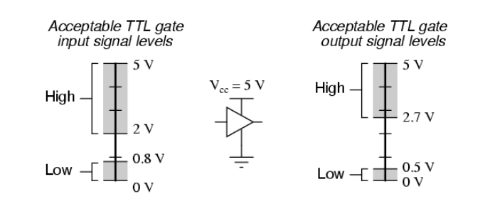
Digital Signals
Voltage levels don’t need to be precise
Wide ranges of circuits can just plug together

Slide 5
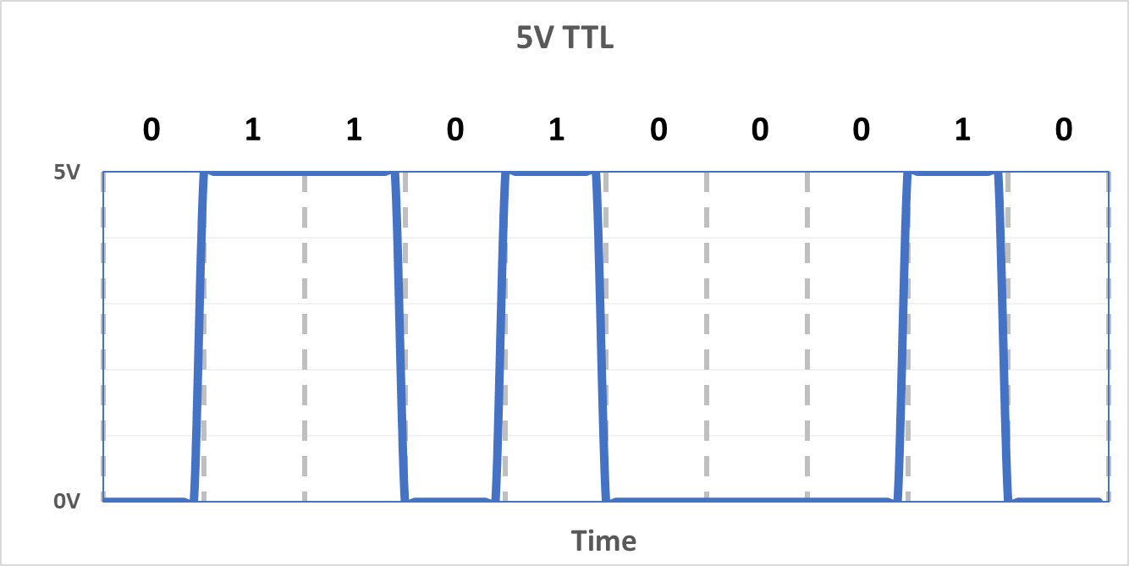
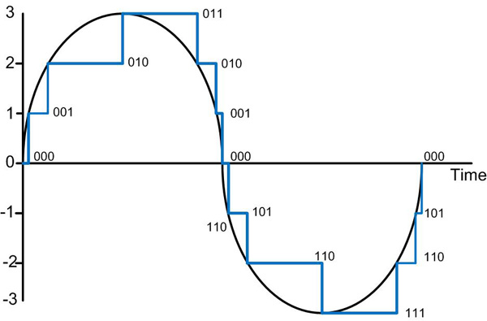
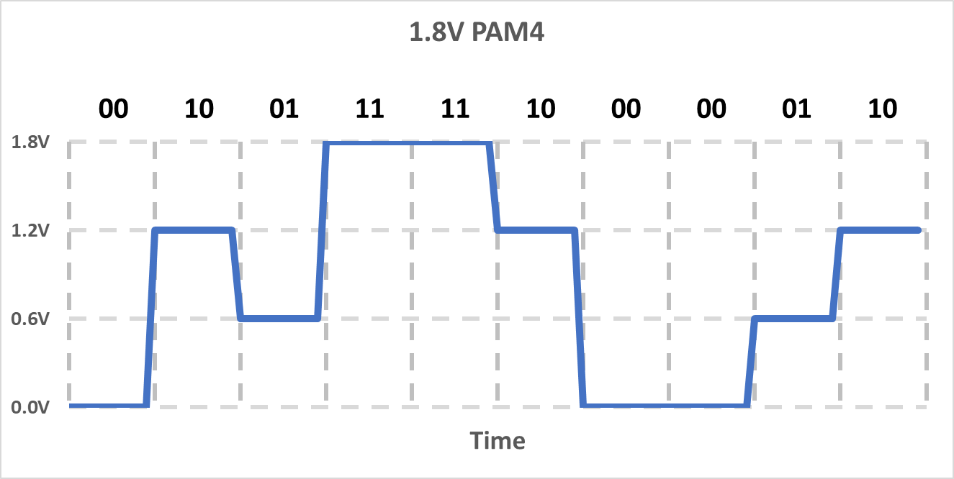
Digital Signal Examples

Slide 6
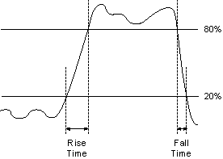
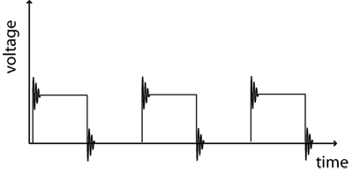
Digital Signal Integrity Issues
Preserve adequate rise/fall times
Keep ringing under control

Slide 7
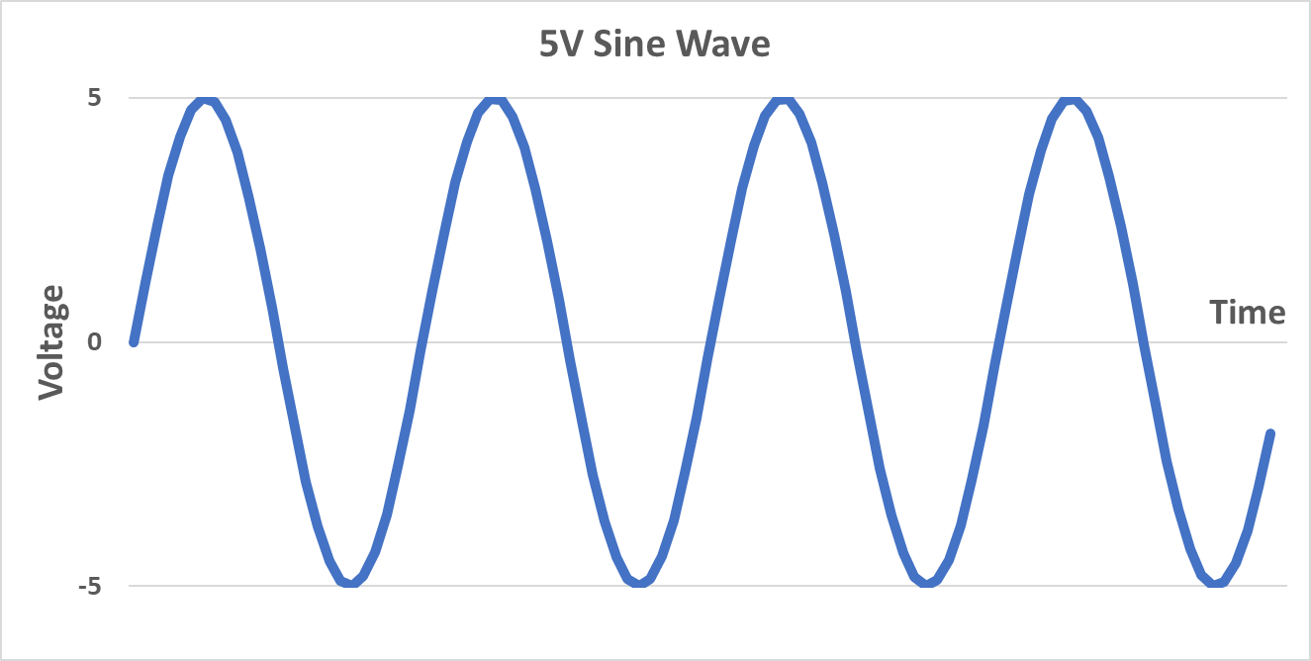
Analog Signals
Continuous in time and voltage (amplitude)
Represent some time varying quantity (e.g. sound pressure)
Potentially infinite information density (theoretically)

Slide 8
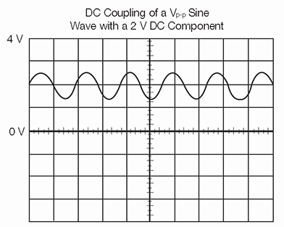
AC vs DC Components
AC
DC

Slide 9
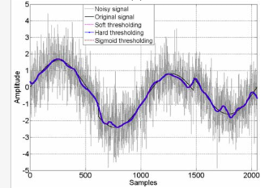
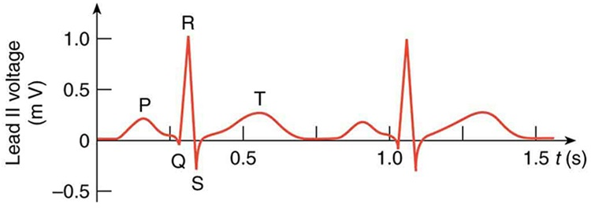
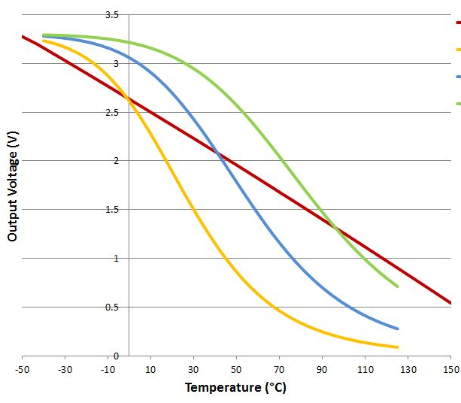
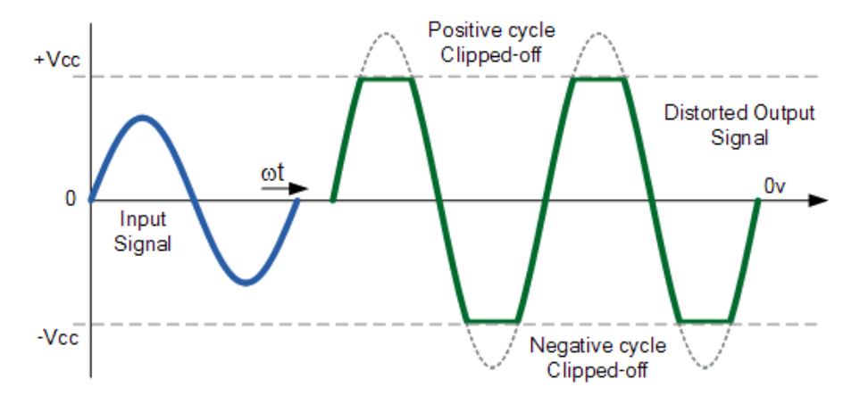
Analog Signal Characteristics
Welcome to the real world!
Can be noisy
Maybe small voltage levels
Linear or nonlinear
Can be distorted

Slide 10
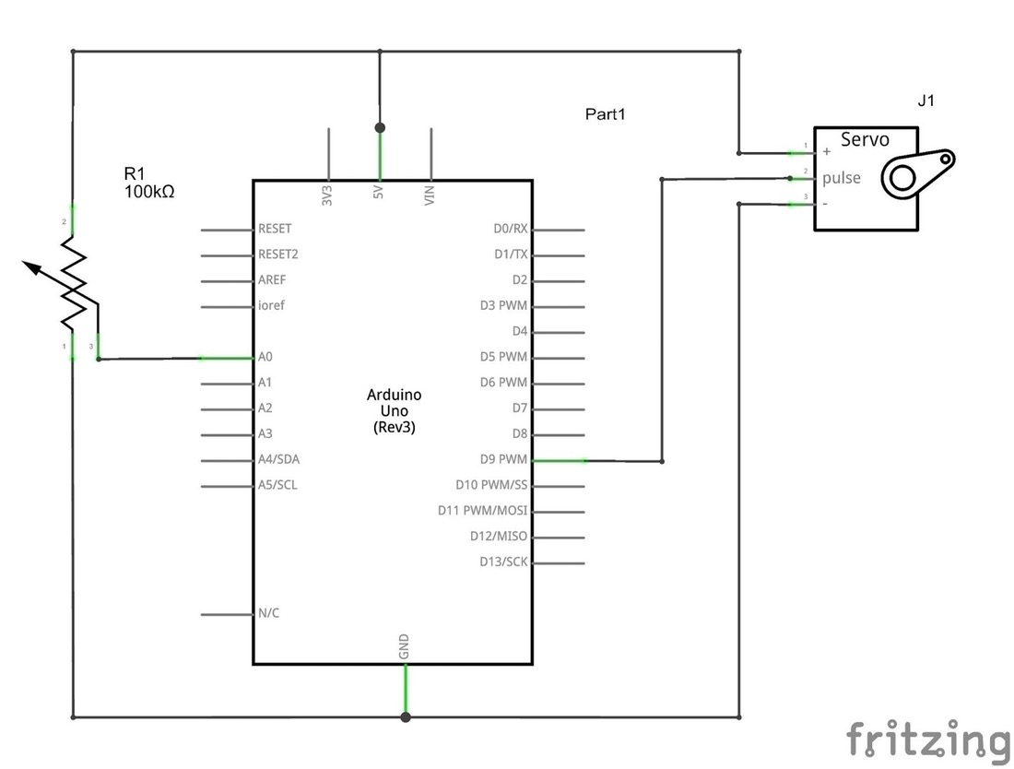
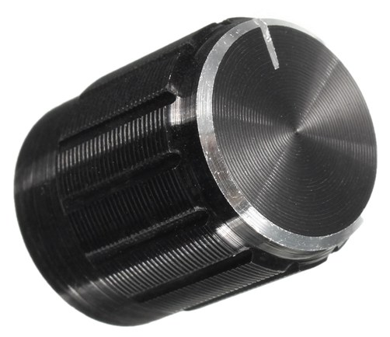
Example: Simple Motor Control
Knob
Analog voltage to be converted to digital by Arduino

Slide 11
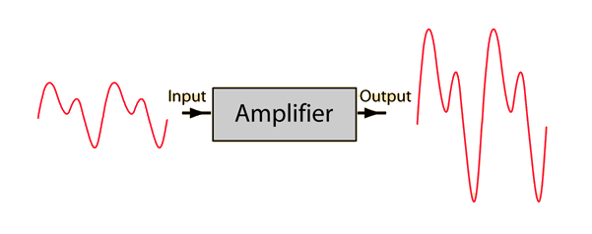
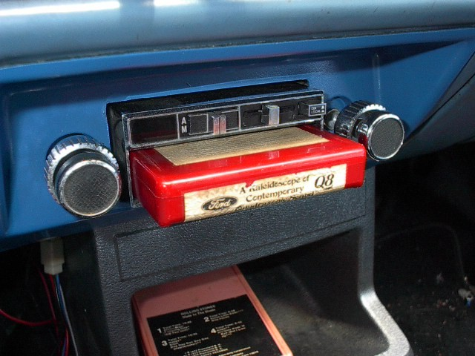
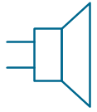
Example: Audio Amplifier
Increase signal amplitude
Input signal has +/- voltage, no DC
Output has +/- voltage, no DC
Not too much distortion

Slide 12
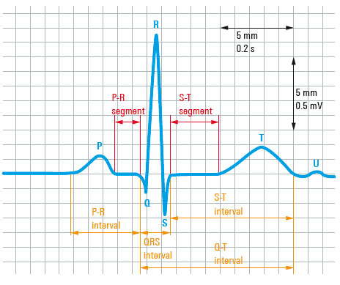
Example Signal - ECG
Non-invasive
12 leads on body
Measures electrical changes on the skin due to heart activity
<1mV signal
Fetal ECG ~1µV
10kHz bandwidth

Slide 13
What makes analog hard?
Digital – thinking process is more like a logic puzzle; circuit elements are often fairly ideal building blocks
Analog –uses non-ideal components and “true” circuit design principles
Signal min/max voltages
DC offsets
Distortion
Bandwidth

Slide 14
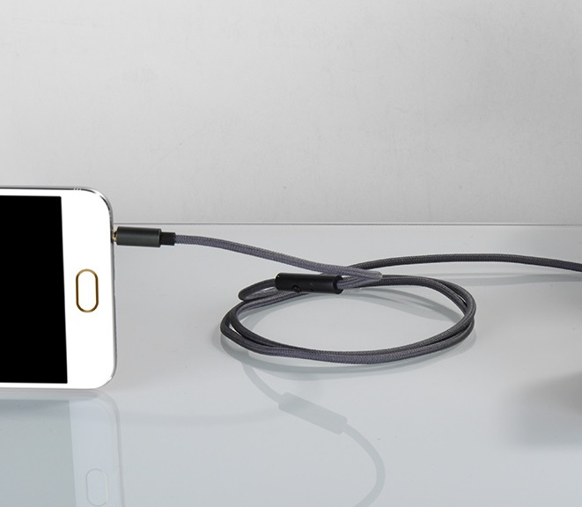
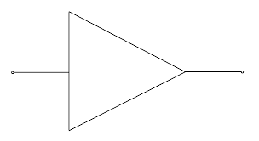
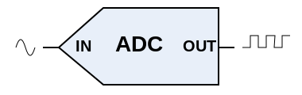
Project Time!
Let’s amplify a signal so it can optimally feed a microcontroller ADC

Slide 15
Signal Observations
5V Supply
+/- 0.45V
(0.9V_{P-P})
0 - 5.0V (5V_{P-P})
Both +/- voltages
DC = 0V
<20KHz
Only + voltage
DC = 2.5V
<20KHz
Amplify x5.5
Add 2.5V DC

Slide 16
Let’s introduce the op-amp!
stuff
V₋
stuff
-
V_{IN}
V_{OUT}
+
V₊
Will set V_{OUT} to force V₋ = V₊

Slide 17
Ideal op-amp
V₋
-
V_{OUT}
V₊
+
Paraphrase: It’s really good at trying to set V_{OUT} to force V₋ = V₊
Ideal Op-Amp: Current into V_{+,} V₋ is zero
V₊ = V₋ (in “closed loop” operation)
Infinite “open-loop” gain: V_{OUT} = (V₊ - V₋) x ∞

Slide 18


Open Loop Systems
A system that does its thing without measuring what’s happening

Slide 19
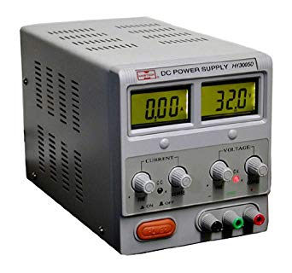
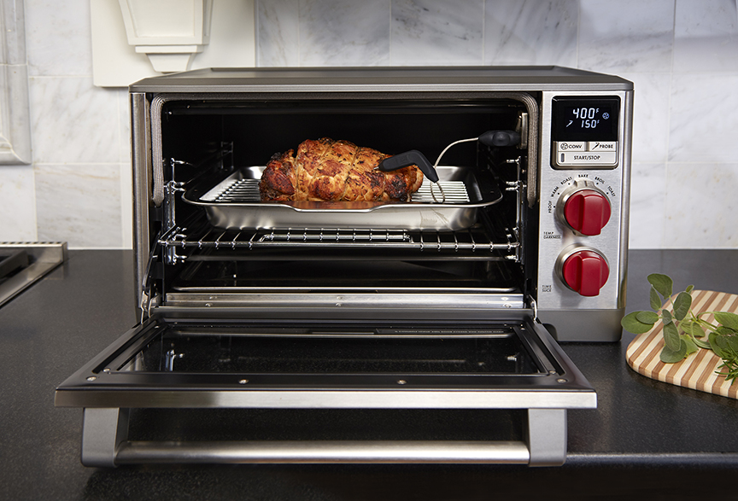
Closed Loop Systems
A system that adapts what it’s doing based on what’s happening

Slide 20
Closed Loop Systems
Valve
Flow Meter
Controller
feedback

Slide 21
Standard Inverting Amplifier
R_{i} = 10kΩ
R_{f} = 20kΩ
V_{IN}
V₋
-
V_{OUT}
V₊
+
V_{OUT} = -V_{IN} x (R_{f}/R_{i})
Ideal Op-Amp: Current into V_{+,} V₋ is zero
V₊ = V₋ (in closed loop circuit)
Infinite open-loop gain

Slide 22
Real op-amps: V_{IN} Limits
MCP6002
“rail-to-rail” input
LM741
not “rail-to-rail”
-
V_{IN}
+
V_{OUT}

Slide 23

Real op-amps: V_{OUT} Limits
MCP6002
“rail-to-rail” output
LM741
not “rail-to-rail”
-
V_{IN}
+
V_{OUT}

Slide 24
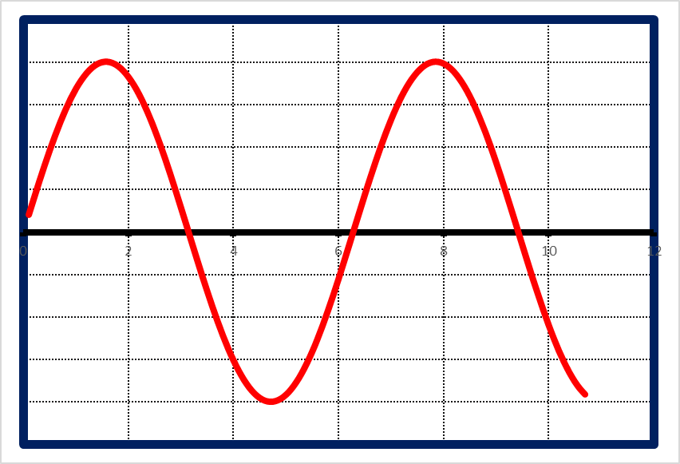
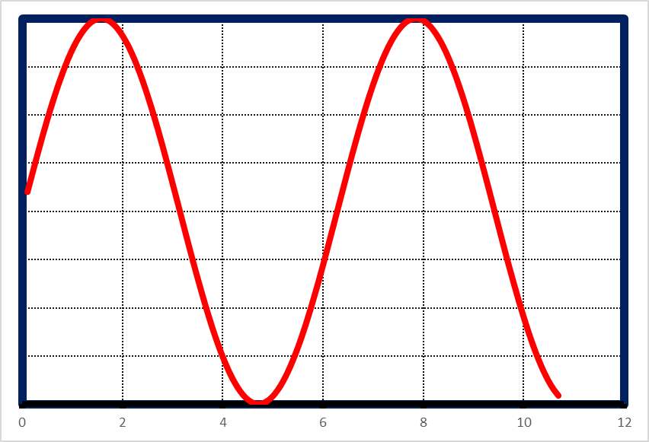
Input/Output DC Voltage Problem
V_{IN} has no DC component (it’s an AC signal centered around 0V DC)
V_{OUT} should vary from 0V to 5V (centered around 2.5V DC)
0.45V
5V
-0.45V
0V
-
V_{IN}
+
V_{OUT}

Slide 25
Real op-amps: I/O DC Offsets
+5V
DC = 2.5V
AC = +/-0.45V
DC = 2.5V
AC = +/-2.5V
100k
+5V
C1
V_{IN}
+
100k
-
V_{OUT}
DC = 0V
AC = +/-0.45V
45K
10K
C2

Slide 26
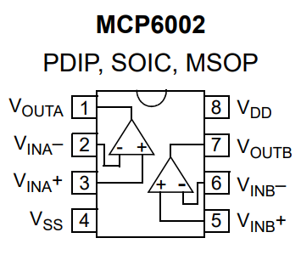
Final Circuit
+5V
100k
1uF
DC = 2.5V
AC = +/-2.5V
100k
1uF
100k
+5V
1uF
V_{IN}
+
V_{OUT}
100k
-
DC = 0V
AC = +/-0.45V
45K
10K
1uF

Slide 27
Making op-amp circuits easier
Become familiar with a few basic op-amp circuits
Inverting amp
Non-inverting amp
Summing amp
Take advantage of proven designs:
application notes
examples in data sheets, websites
op-amp cookbooks
Go-to parts:
Have a go-to rail/rail I/O 5V op-amp (KM MCP6002)
Have a go-to split-supply 30V op-amp (KM NE5534)
Unity gain stable, GBW ~MHz

Slide 28
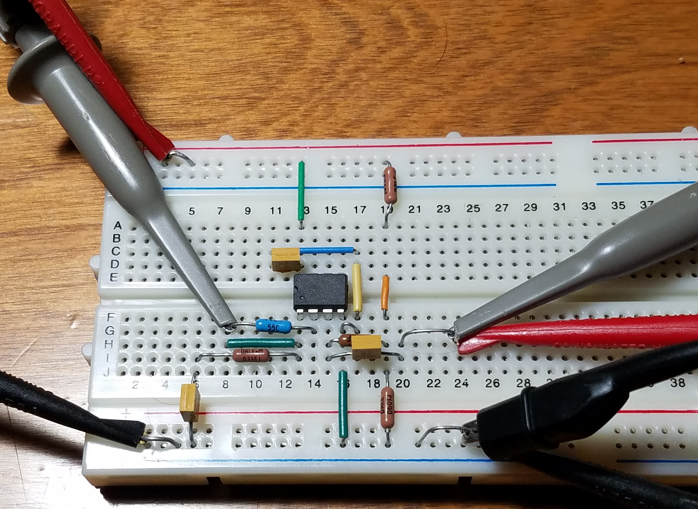
Finished Circuit

Slide 29
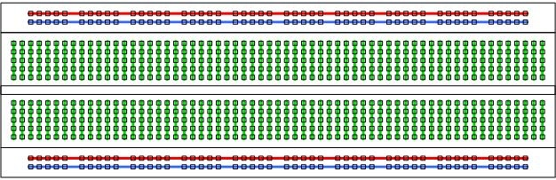
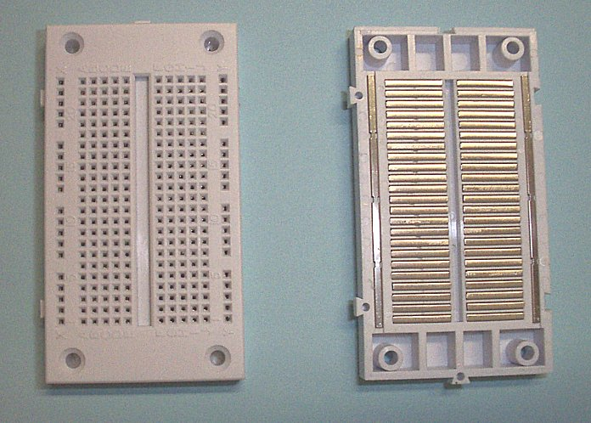
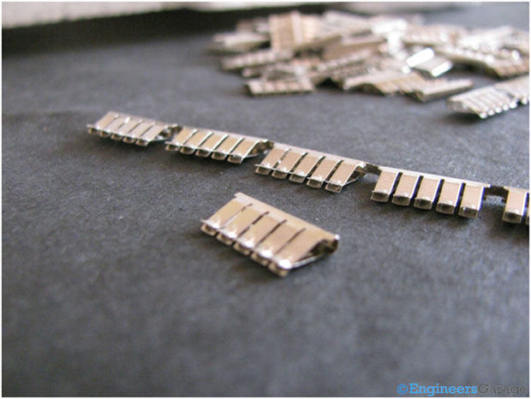
Using a breadboard
Circuit connections
Power supply buses
Internals of board

Slide 30
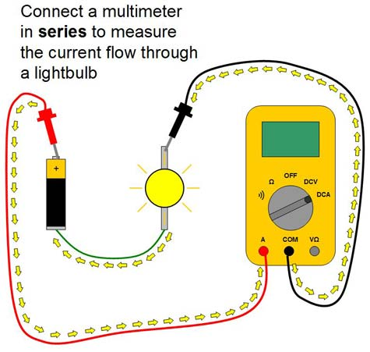
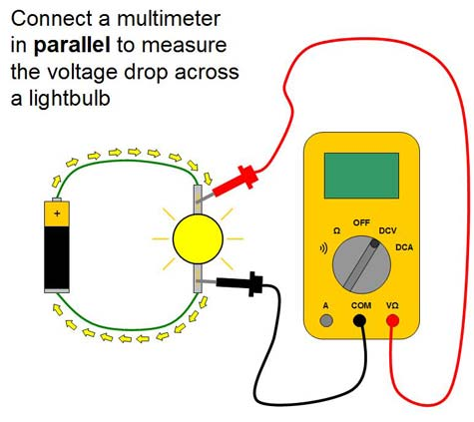
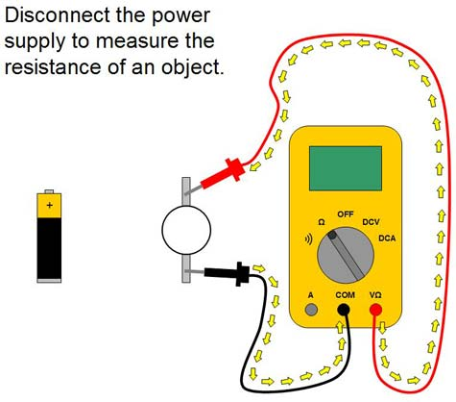
Using a Multimeter
Voltage across
Current through
Resistance between
Continuity between

